Slide 1
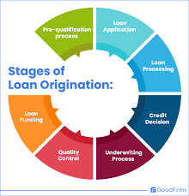
Loan repayment assessment in banking
- The task is to build a model based on the
details provided in KnowledgeHut Hackathon…

Slide 2
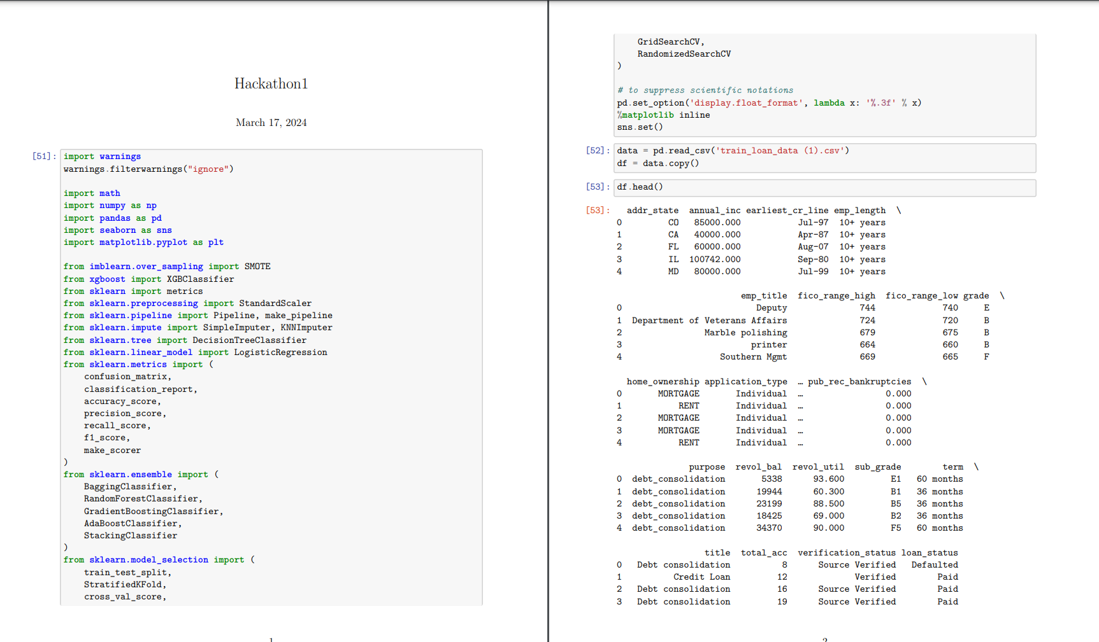
Statistics descriptive analysis and eda
The starts from here

Slide 3
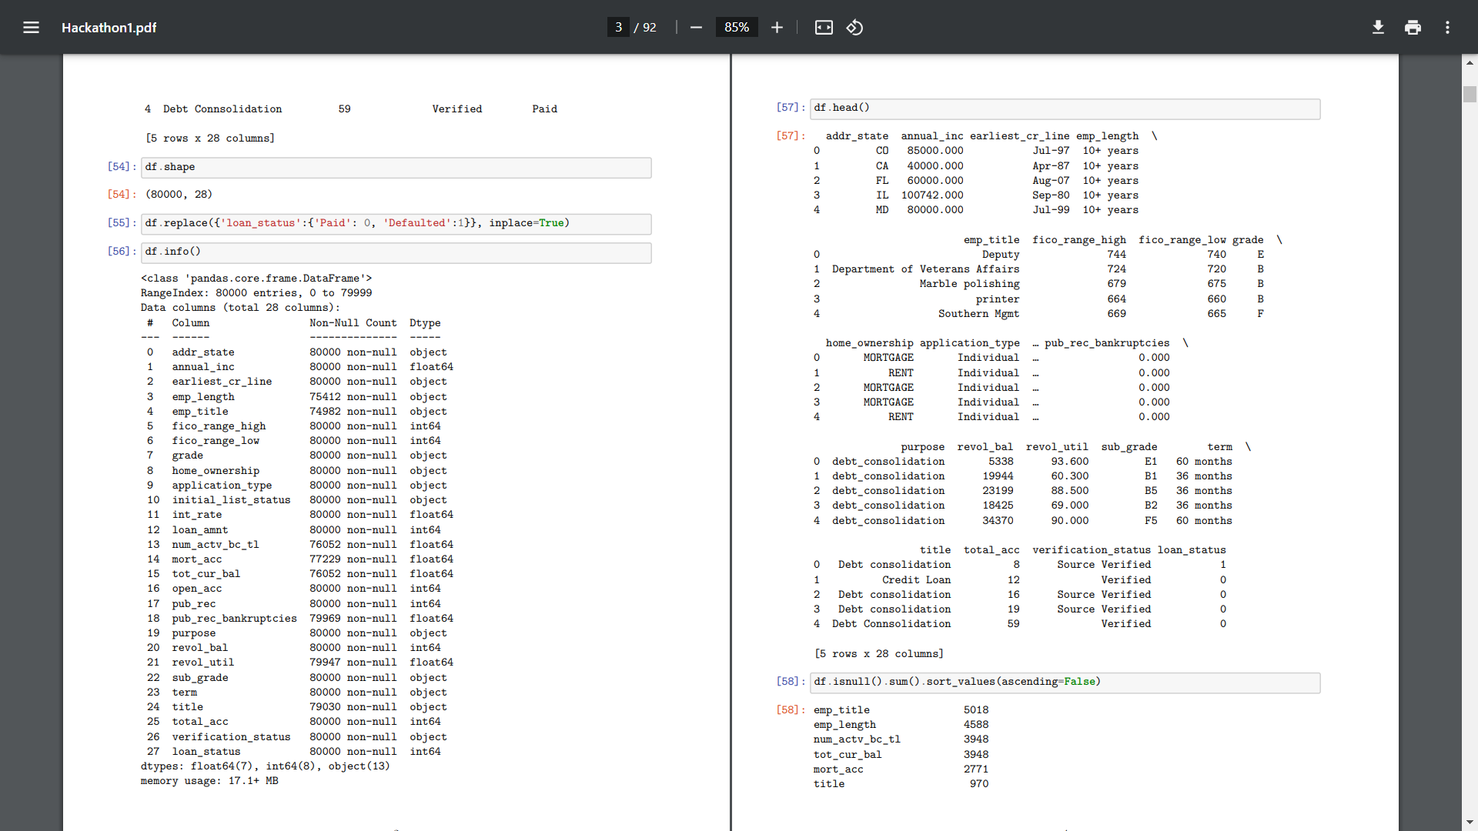
EDA
Exploratory
Data
Analysis and
A bit of Data
Presprocessing.

Slide 4
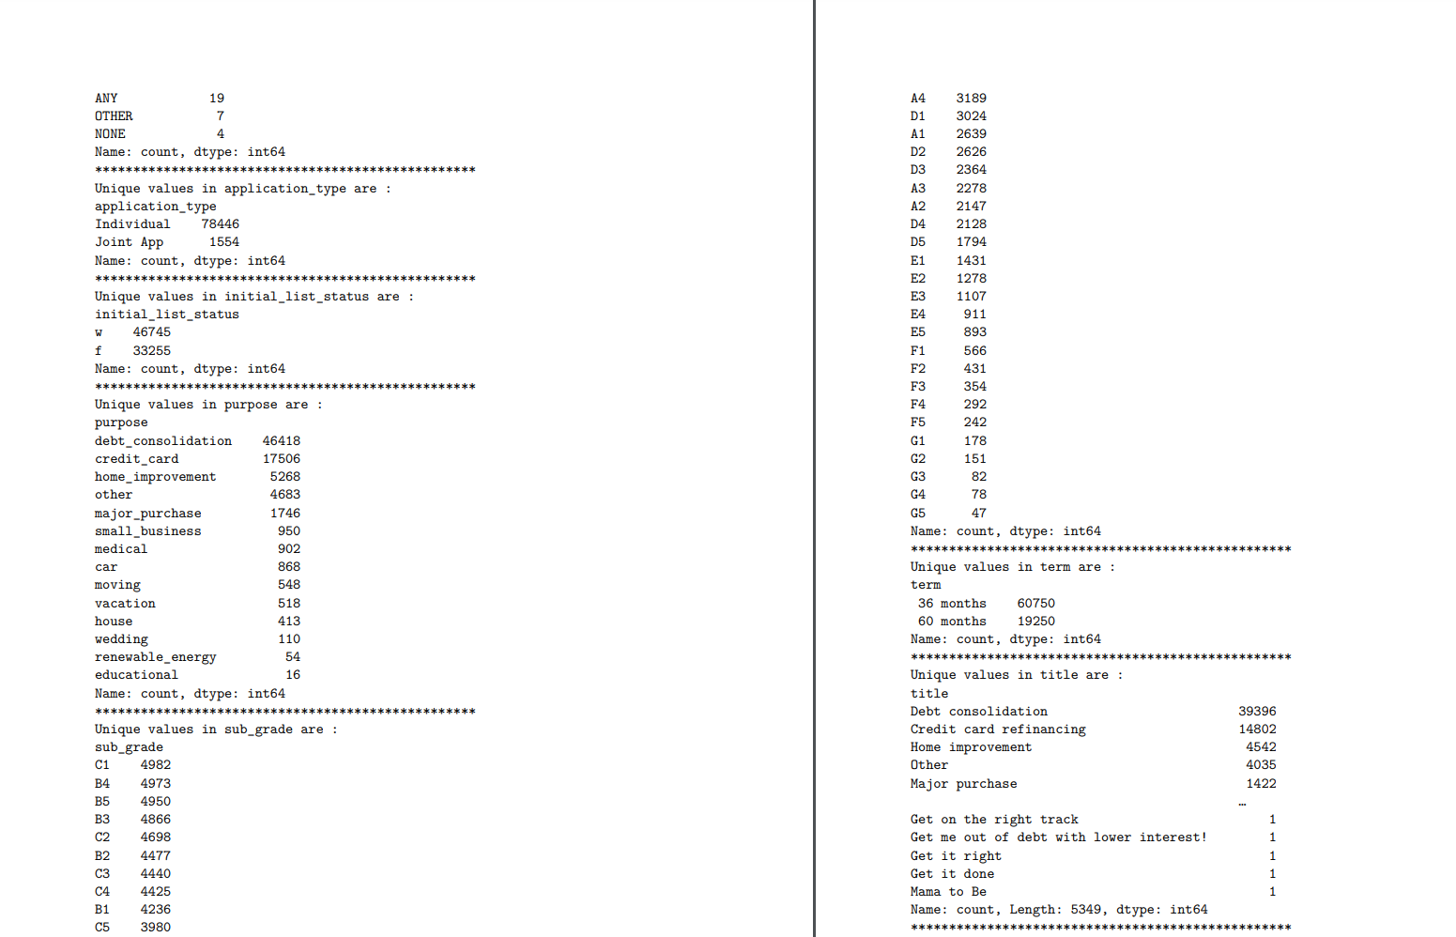
More Insights about dataset

Slide 5
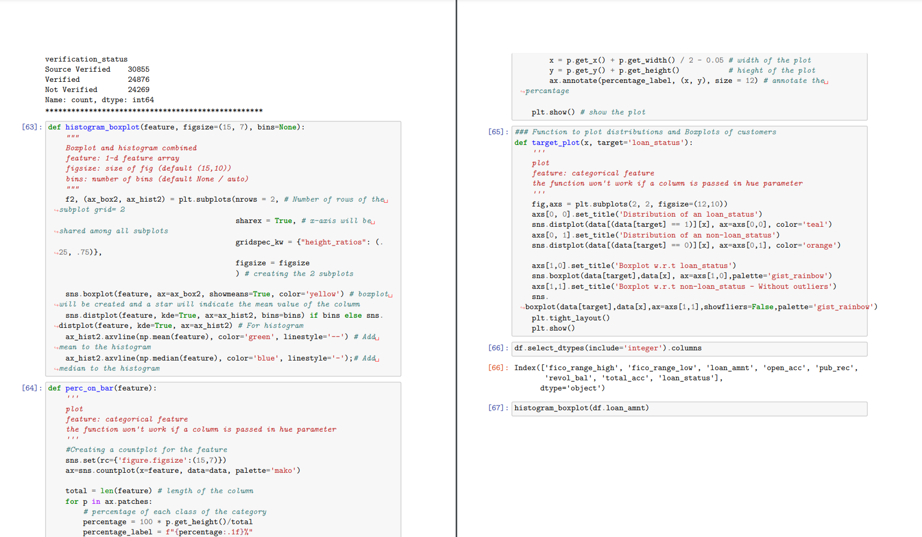
Feature scaling begins

Slide 6
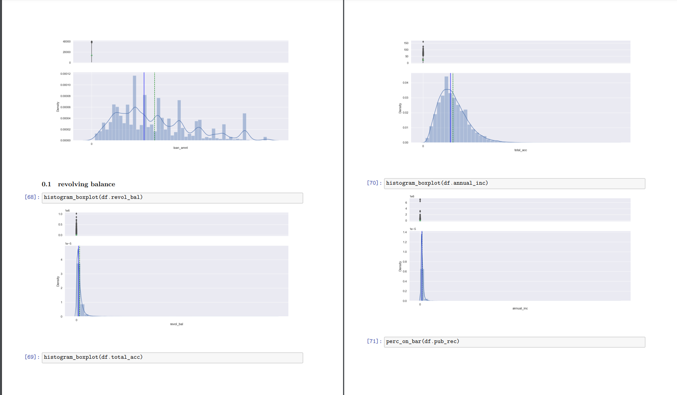
Raw Insights About our data

Slide 7
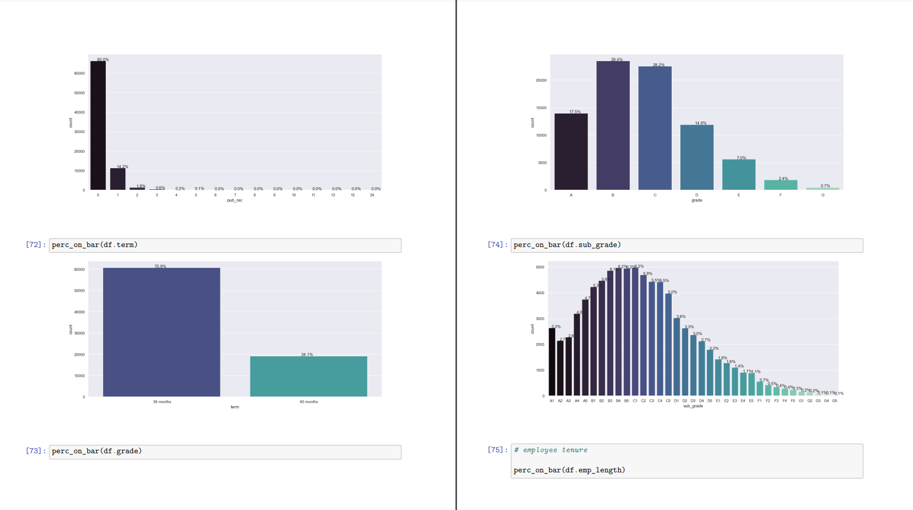
And more insights

Slide 8
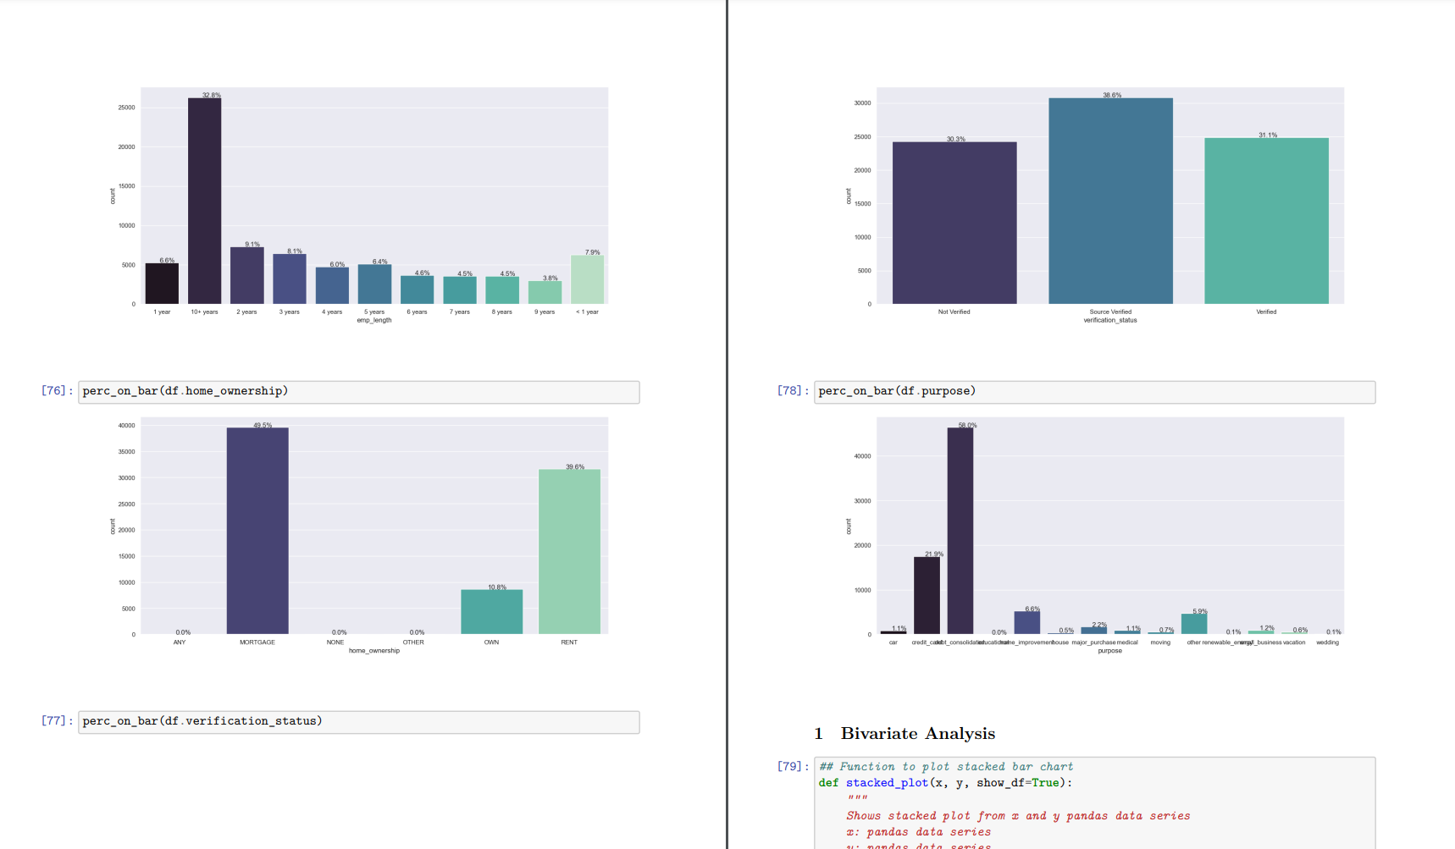
Statehood

Slide 9
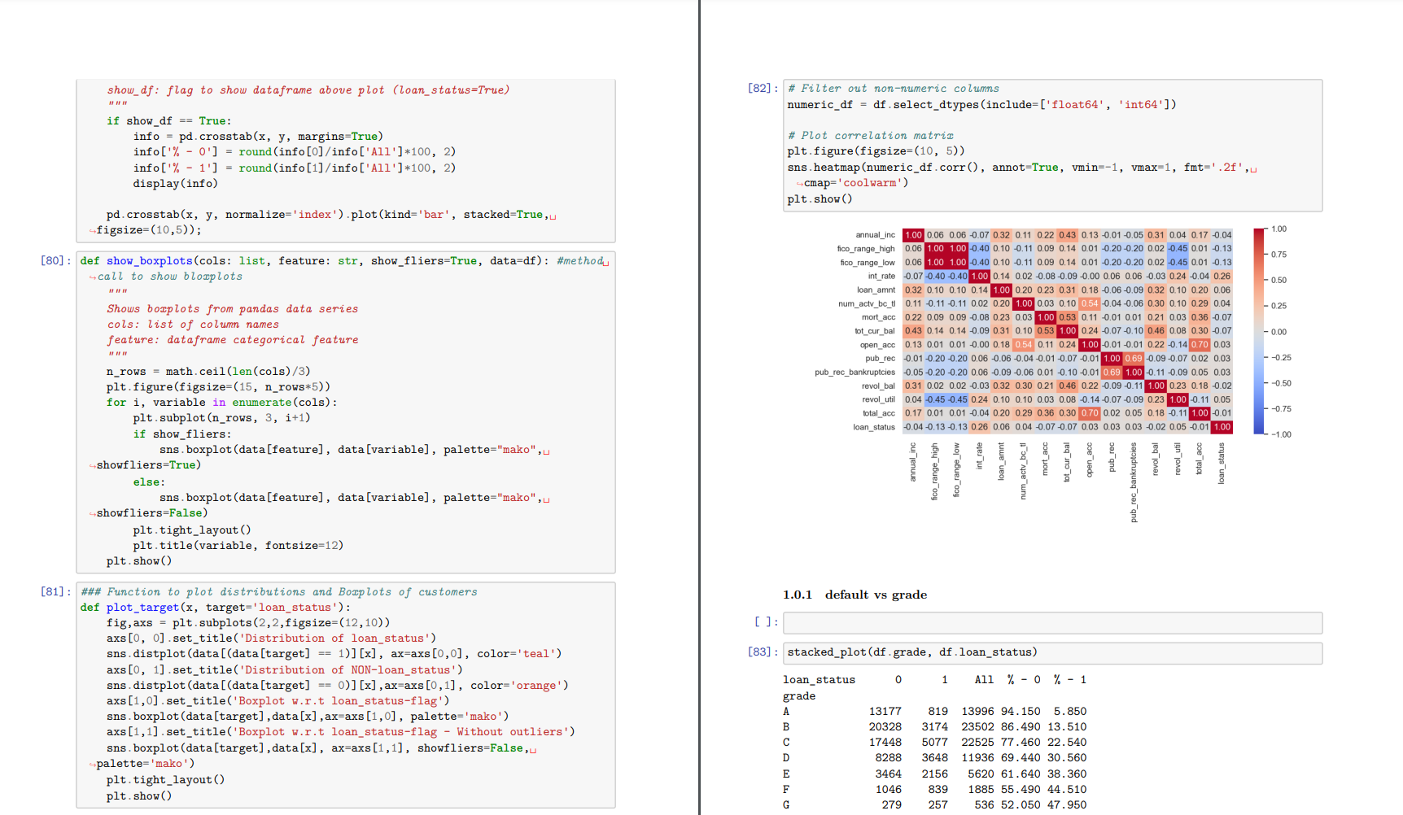
Insights using Heat maps

Slide 10
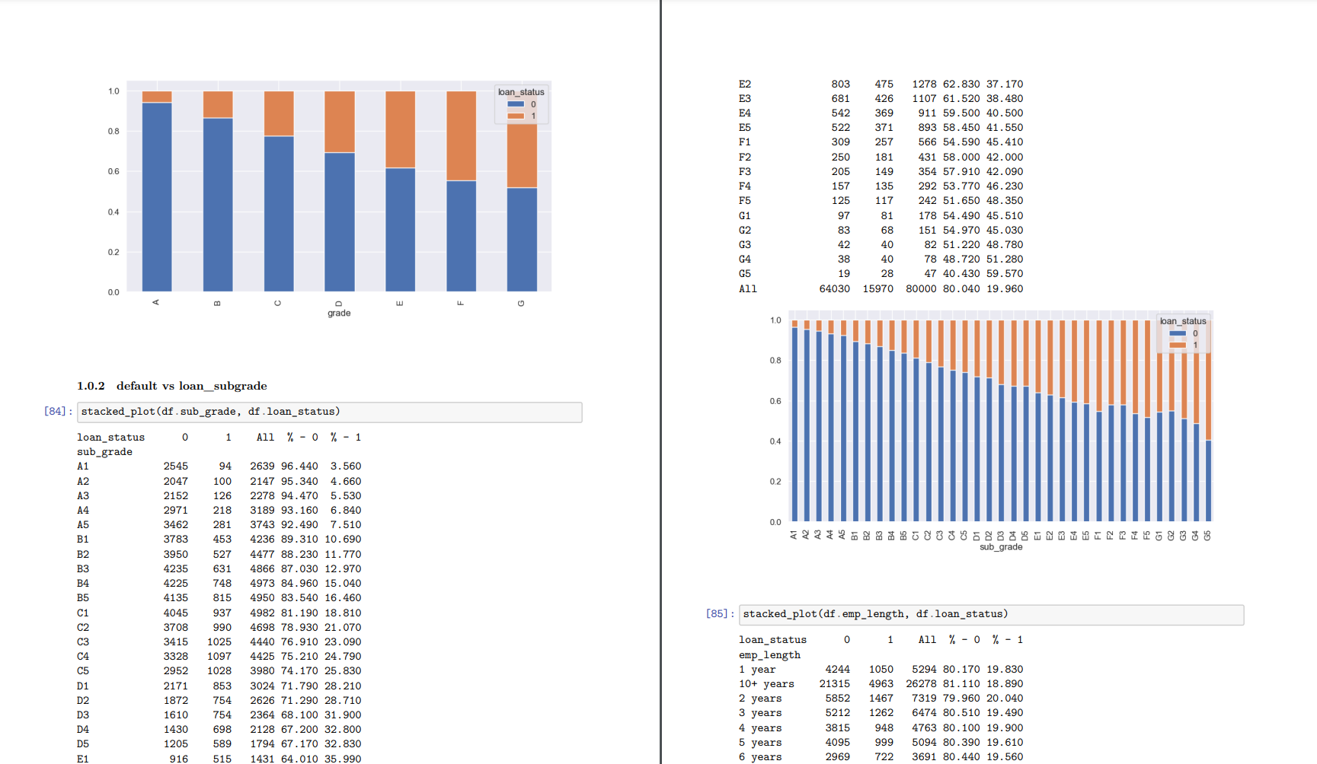

Slide 11
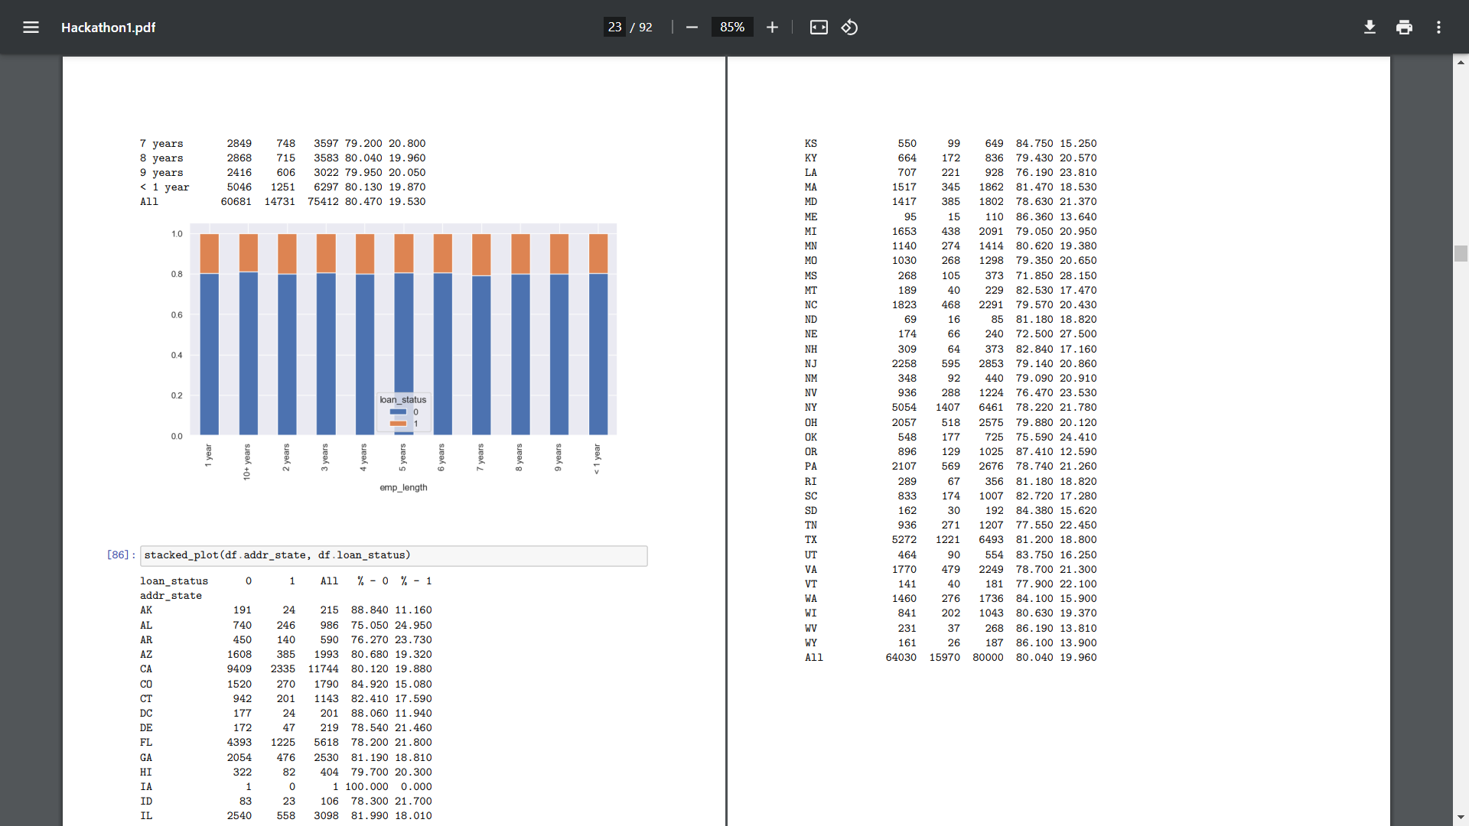
…

Slide 12
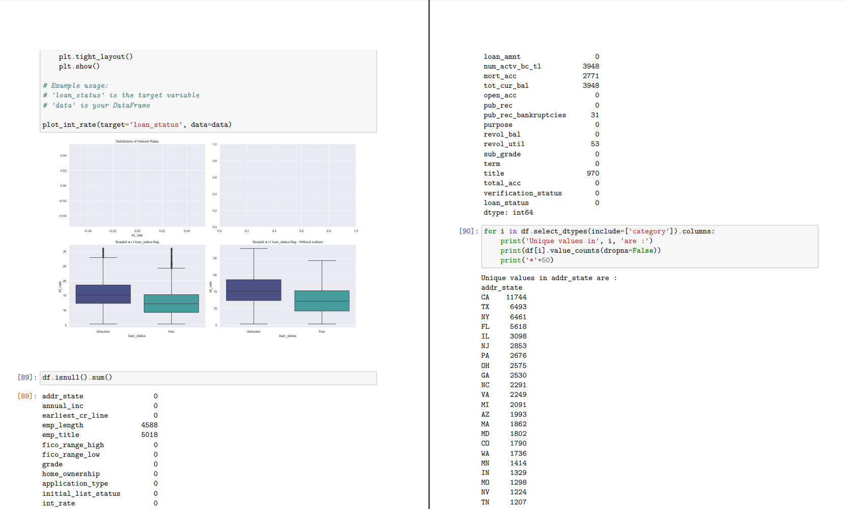
Economy

Slide 13
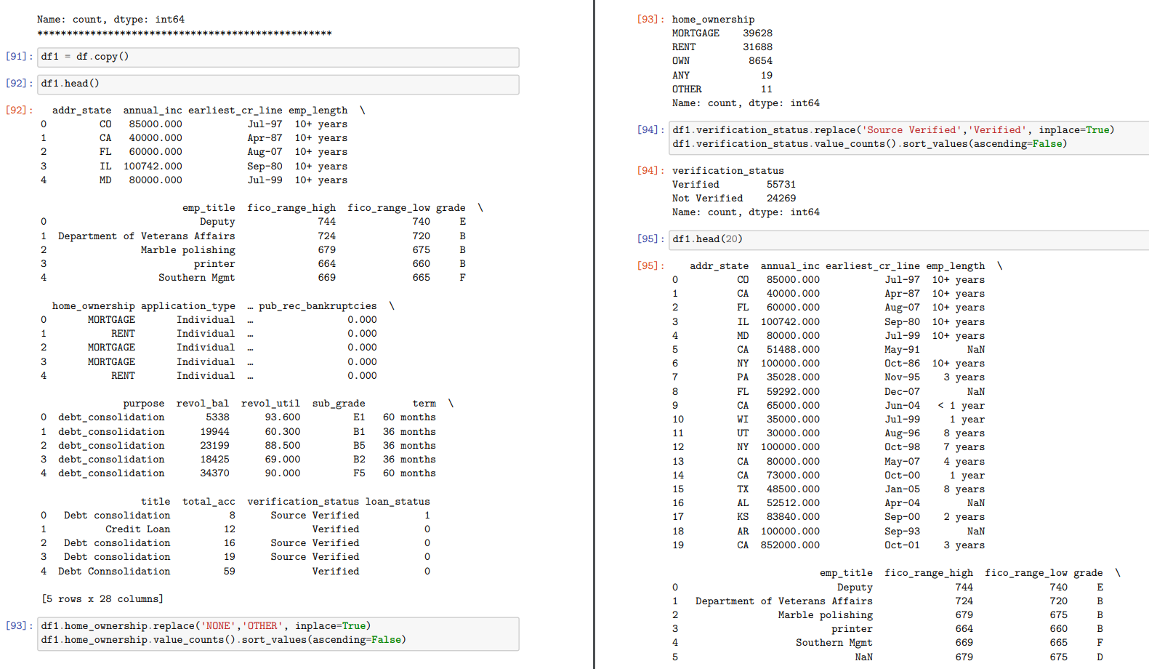
Feature engineering

Slide 14
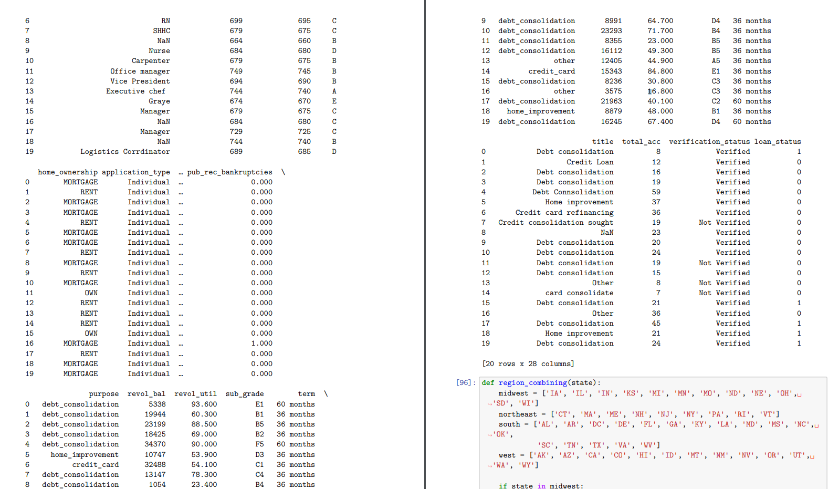
Cross validation starts here

Slide 15
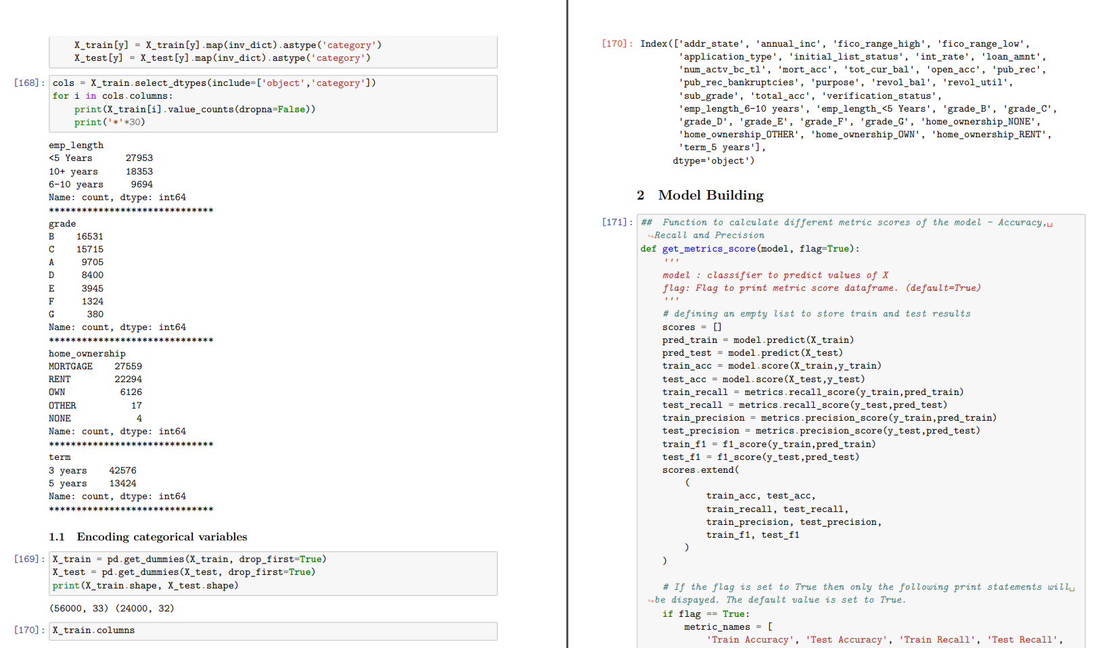
Model building starts

Slide 16
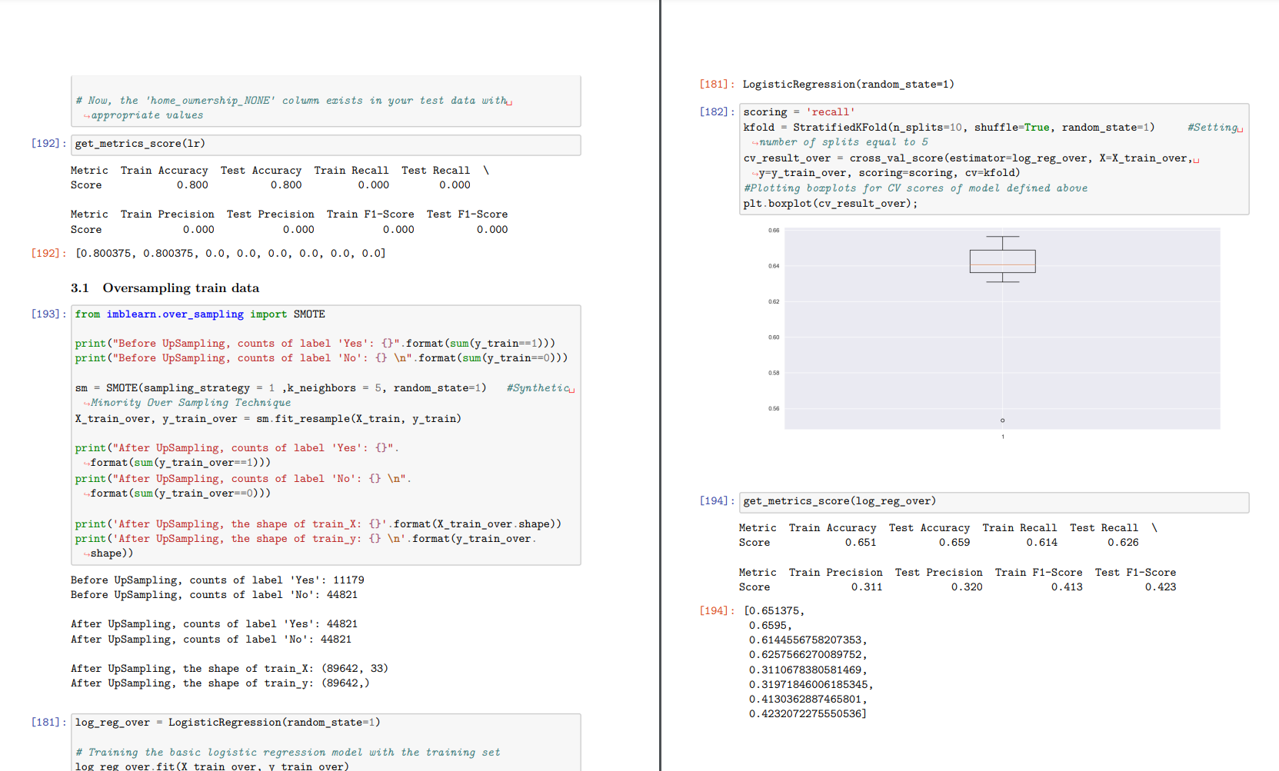
Ensemble techniques - Bagging, Boosting

Slide 17
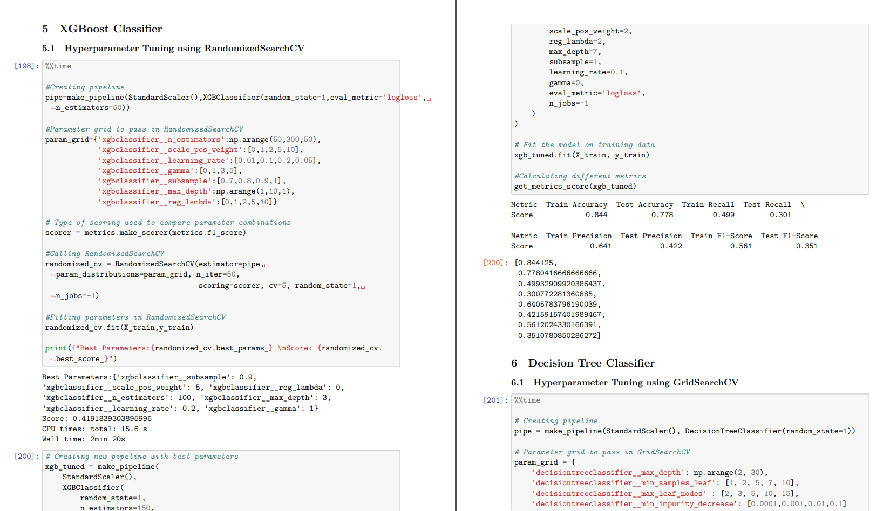
Grid search, Tuning Hyper parameters

Slide 18
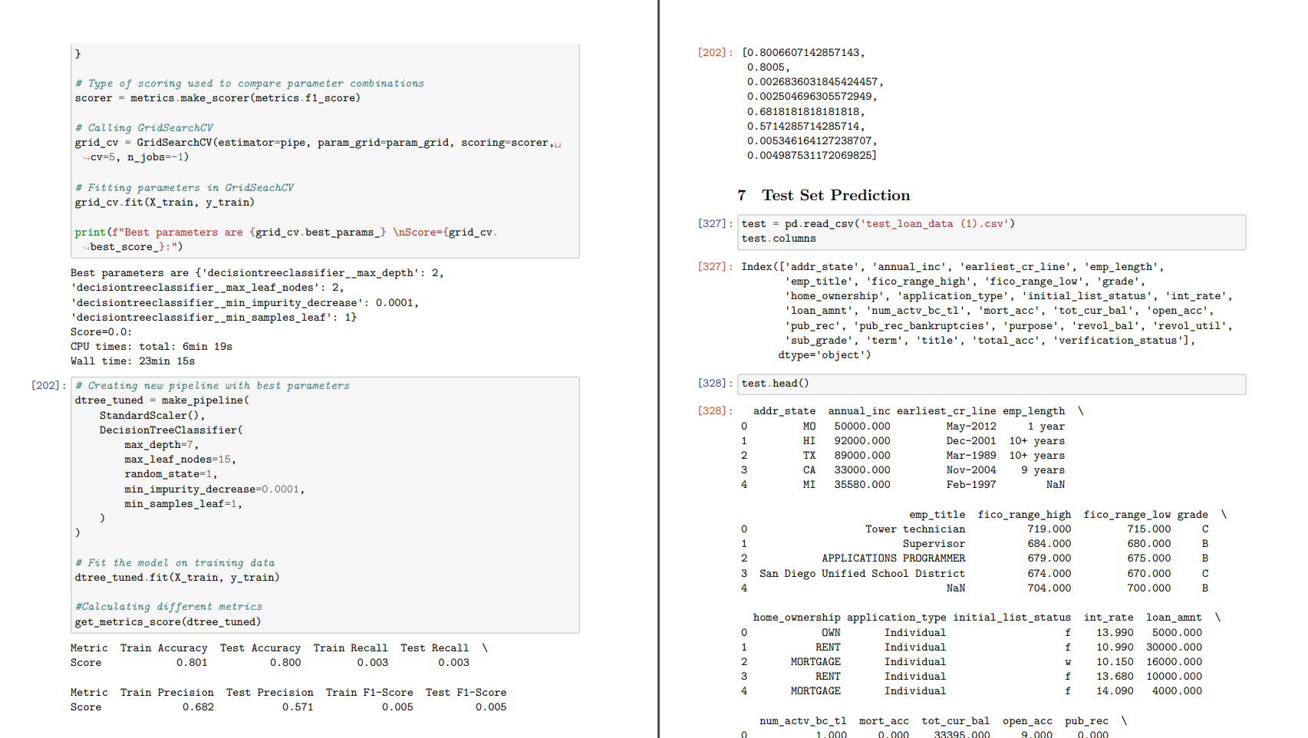
Evaluation metric: F1 - Score and Test Set

Slide 19
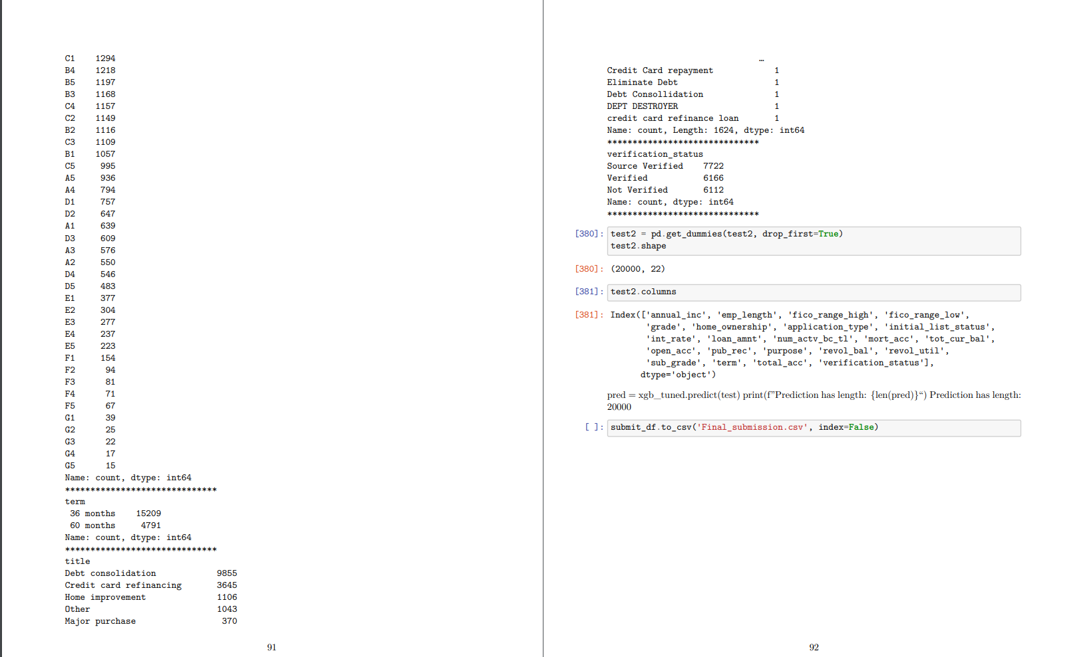
And the model predictions are ready to be used

